Slide 1
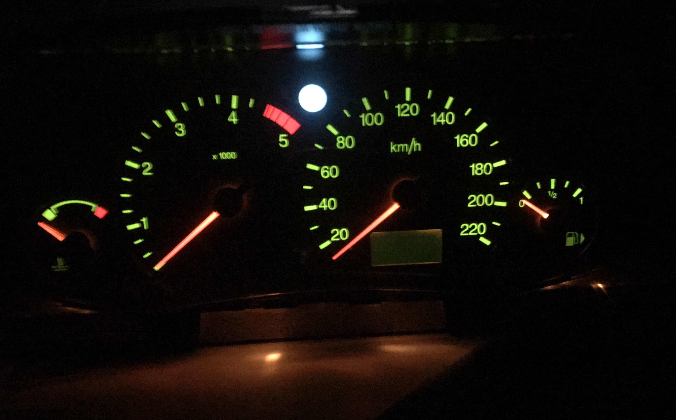
CarHackingLab
ICSim

Slide 2
Setup

Slide 3
Needed Software
Download VMware Player here: https://www.vmware.com/products/workstation-player.html
Download Ubuntu here: https://ubuntu.com/
Follow steps for ICSim here: https://github.com/zombieCraig/ICSim
Resources for this lab:
The Car Hacker’s Handbook
https://hackaday.io/project/175126-learn-how-to-hack-a-car-remoticon-workshop
This workshop is based on the workshop from Hackaday’s remoticon in 2020. If you’re getting stuck, you can also use these resources

Slide 4
Installation steps
Install VMware Player
After installing and starting VMware, create a new virtual machine and select the downloaded Ubuntu .iso file
Follow the installation steps and leave the default values

Slide 5
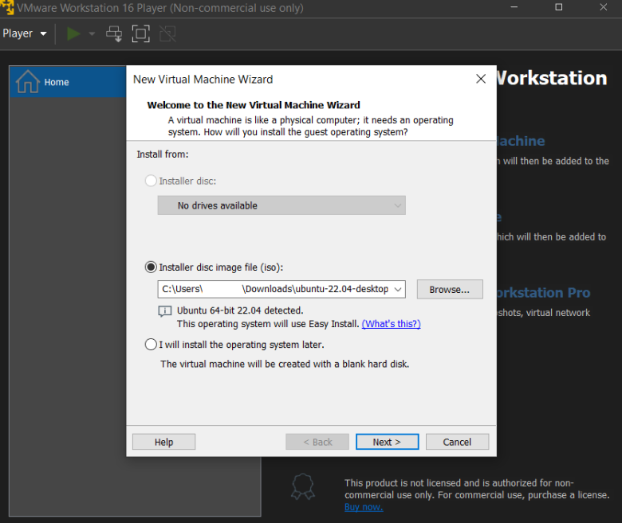
Creating a new Virtual Machine with Ubuntu
Make sure to select your downloaded Ubuntu .iso file
Leave the rest of the options as default, we don’t need special settings for this lab

Slide 6
ICSim
Open a terminal in Ubuntu
Install git, make, and gcc with ‘sudo apt install git make gcc’
Head over to https://github.com/zombieCraig/ICSim , we want to get the git repo with:
git clone https://github.com/zombieCraig/ICSim.git
Install needed libraries:
sudo apt-get install libsdl2-dev libsdl2-image-dev can-utils
Change to directory ICSim, which you just download

Slide 7
Setting up Virtual CAN Interface
Change to directory ICSim, which you just downloaded and enter following commands:
make
./setup_vcan.sh
./icsim vcan0
./controls vcan0

Slide 8
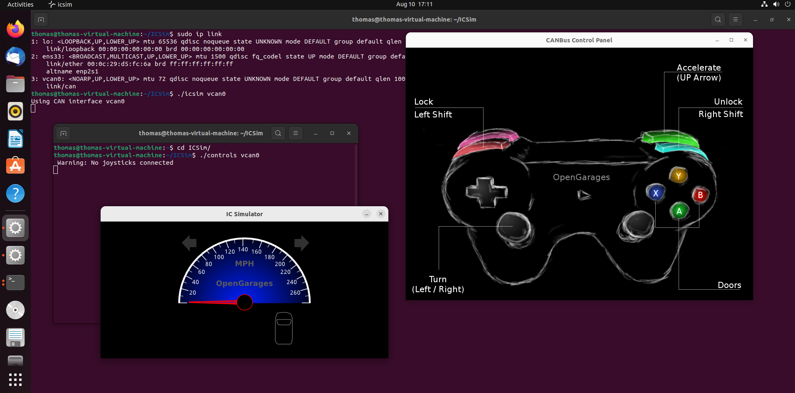
Start ICSim and Controls in Ubuntu

Slide 9
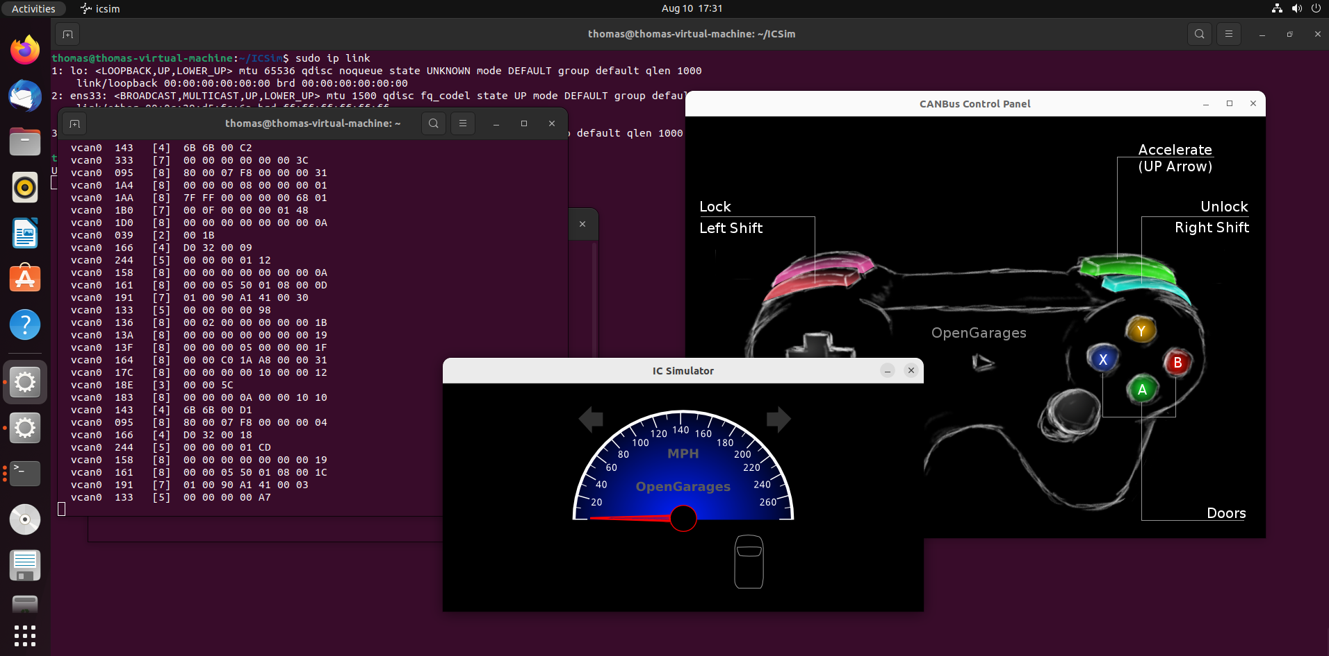
CAN Messages
In another terminal window, run:
candump vcan0
You should see the CAN messages of ICSim

Slide 10
Replay Attack with ICSim

Slide 11
Replay Attack
Record the CAN messages with:
candump –L > open_door.log vcan0
While recording, open the doors using the controller (it’s a bit tricky to open the doors with the controller, so hold the left shift key and press the right or the other way around until the doors open)
Have a look at the dump:
head –n 10 open_door.log | log2long
Replay the file:
canplayer –I open_door.log

Slide 12
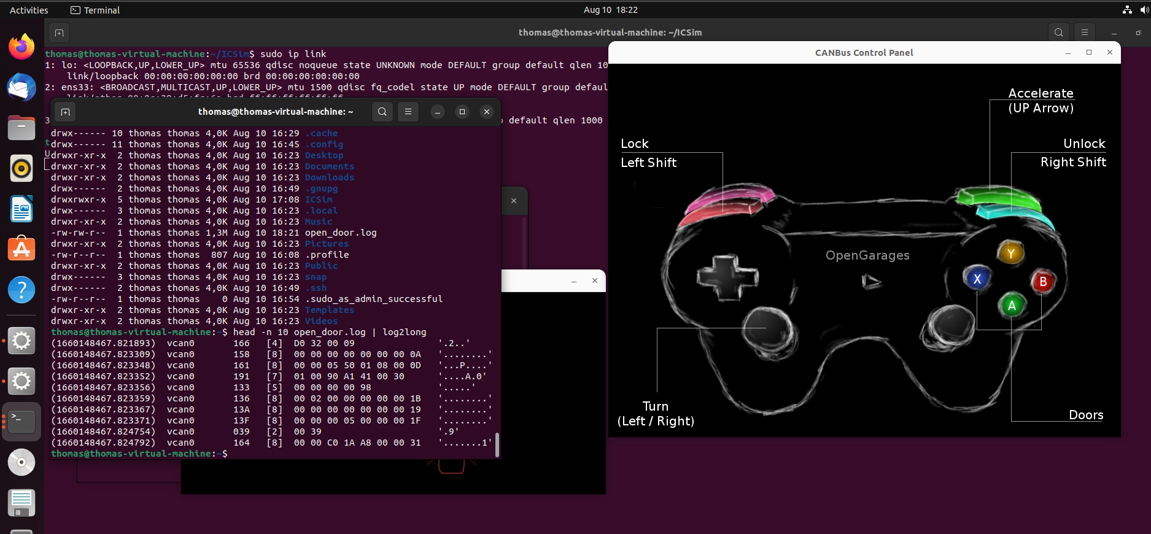
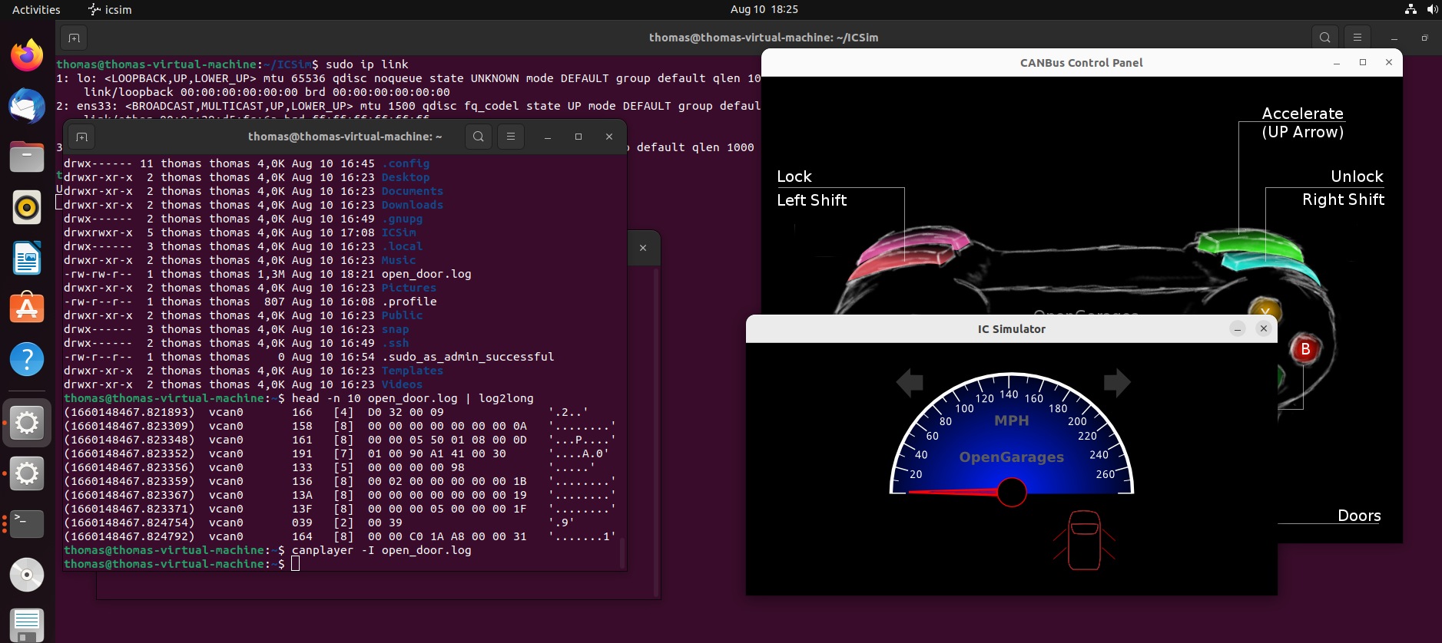
Replay Attack (cont.)
If it doesn’t work with opening the doors too well, you can also try it with the speed or turning left/right.

Slide 13
Find the exact command

Slide 14
Finding the CAN command that opened the door
Count the lines in your file:
wc –l open_door.log
Split the log file:
Split –l open_door.log
If the file is too long or if you get stuck, head over to https://hackaday.io/project/175126-learn-how-to-hack-a-car-remoticon-workshop , download the file content and try it with the 100 lines file mentioned in that workshop

